Slide 1

The linux programming interface
14. FILE SYSTEM
최광진, 권보윤

Slide 2
The linux programming interface
CONTENTS
File system
Device Special Files
Disks and partitions
File systems
I –nodes
The virtual file system(VFS)
Journaling file systems
Single Directory Hierarch and Mount Point
Mounting and Unmounting File system
Advanced Mount Features
A virtual memory file system :tempfs
Obtaining information about a file system : statvfs()
summary

Slide 3
The linux programming interface
14.1 Device Special Files
- The concept of a Disk devices
A device special files corresponds to a device on the system.
Within the kernel, each device type has a corresponding device driver, which handles all i/O requests for the device.
A device driver is a unit of kernel code that implements a set of operations that correspond to input and out put actions on an associated piece of hardware.
The API provided by device drivers is fixed, and includes operations corresponding to the system call
Some devices are real, such as mice, disks, and tape drivers.
Others are virtual, meaning that there is no corresponding hardware. ( an abstract device with an API)
Devices can be divided into two type
Character devices
Block devices

Slide 4
The linux programming interface
Command : mknod().
mknod라는 명령어는 장치파일(FIFO, Block, Character)을 만들때 사용하는 명령어이다. 일반적으로 블록디바이스, 문자디바이스라고 하는 파일을 생성할때 사용하며 리눅스시스템에 새로 장착되는 하드웨어의 장치파일생성시에 주로 사용한다..
Command : mkfifo().
리눅스 명령어 mkfifo는 FIFO 파이프를 생성하는 명령어다. FIFO는 프로세스 간 통신을 위해 사용된다..

Slide 5
The linux programming interface
- Device IDs
Each device file has a major ID number and a minor ID number.
The major ID identifies the general class of device, and is used by the kernel to look up the appropriate driver for this type of device.
The minor ID uniquely identifies a particular device within a general class.
A device’s major and minor IDs are recorded in the i-node for the device files.

Slide 6
The linux programming interface
14.2 Disks and Partitions
- Look at how disks are organized and divided into partitions.
- Device drivers
A hard disk driver is a mechanical device consisting of one or more platters that rotate a high speed.
Magnetically encoded information on the disk surface is retrieved or modified by read/ write heads that move radially across the disk.
Physically, information on the disk surface is located on a set of concentric circles called tracks.( Tracks themselves are divided into a number of sectors, each of which consists of a series of physical blocks)
Total time = Seek time + rotational latency + transfer time.

Slide 7
The linux programming interface
- Device partitions
Each disk is divided into one or more (nonoverlapping) partitions. Each partition is treated by the kernel as a separate device residing under the /dev directory.
- A disk partition may hold any type of information, but usually contains one of the following:
A file system holding regular files and directories.
A data area accessed as a raw-mode device
A swap area used by the kernel for memory management.

Slide 8
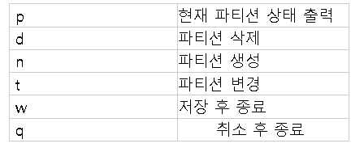
The linux programming interface
디스크 사용 명령어
df : 디스크의 마운트 상태와 용량을 확인
fdisk : 물리적인 디스크에 논리적인 파티션을 생성하는 명령어
mkfs : 파티션에 파일 시스템을 만들어준다.
Mount : 각 장치에 구성된 파일 시스템을 전체 파일 나무 구조에 붙이는 데 사용한다. 즉, 운영시스템이 지정된 위치에서 파일 시스템을 사용할 수 있게 만들어준다.
Unmount : 마운드제거
Blkid : 파티션정보확인

Slide 9




The linux programming interface
Swap : 하드디스크를 메모리처럼 사용하는 기법
mkswap : swap 파티션이나 swap 파일을 생성하는 명령어
swapon : swap 파티션이나 swap 파일을 구동하는 명령어
swapoff : swap 파티션이나 swap 파일을 중단하는 명령어

Slide 10
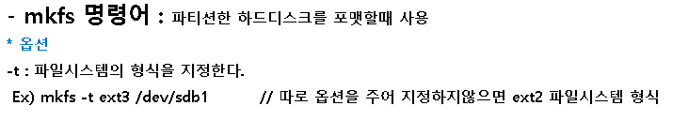
The linux programming interface
14.3 File systems
A file system is an organized collection of regular files and directories.
A file system is create using the mkfs command

Slide 11
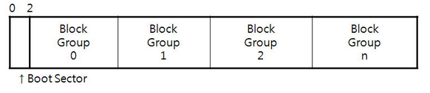
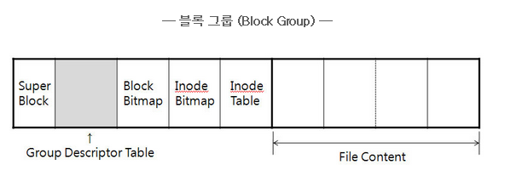
The linux programming interface
- The ext2 file system
The second Extended file system, which is the successor to the original linux file system, ext.
Boot block : This is always the first block in a file system.
Superblock : This is a single block, immediately following the boot block, which contains parameter information about the file system.
I-node table “ Each file or directory in the file system has a unique entry in the i- node table.
Data block: The great majority of space in a file system is used for the blocks of data the form the files and directories residing in the file system.

Slide 12
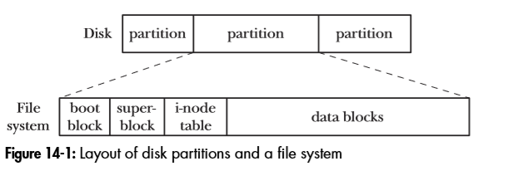
The linux programming interface
- file-system structure
The basic unit for allocating space in a file system is a logical block, which is some multiple of contiguous physical blocks on the disk device on which the file system resides.
Shows the relationship between disk partitions and files system, and shows the parts of a (genetic) files system.

Slide 13
The linux programming interface
14.4 I-nodes
- File system ‘s information.
I-nodes are identified numerically by their sequential location in the i-node table.
File type
Owner
Group
Access permissions for three categories of user : owner, group, other.
Three timestamps
Number of hard links to the file.
Size of the file in bytes.
Number of blocks actually allocated to the files, measured in units of 512-byte blocks.
Pointers to the data blocks of the file.

Slide 14
The linux programming interface
14.5 The Virtual File system(VFS)
.
The virtual file system(virtual file switch) is a kernel feature that resolved t problem which differs in the details of its implementation by creating an abstraction layer for file-system operations.
The VFS defines a generic interface for file system operations.
Each file system provides an implementation for the VFS interface.
The VFS interface includes operations corresponding to all of the usual system calls for working with file systems and directories
Open(), read(), write(), lseek(), close(), truncate(), stat(), mount(), umount(), mmap(), mkdir(), link(), unlink(), symlink(), and re;name()
The VFS abstraction layer is closely modeled on the traditional UNIX file system model.

Slide 15
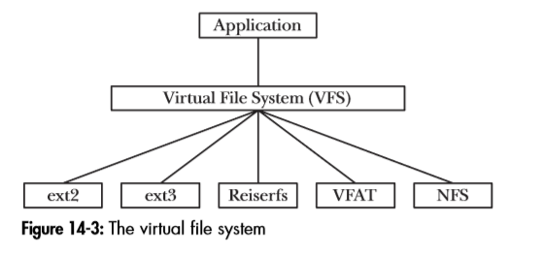
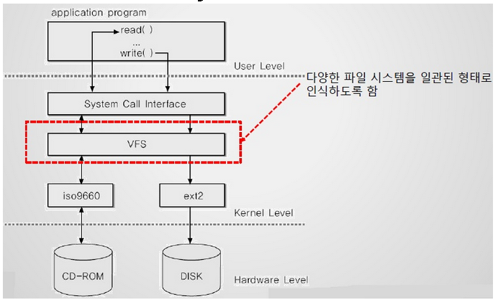

Slide 16
The linux programming interface
14.6 Journaling File systems
주 파일 시스템에 변경사항을 반영하기 전에, 저널(주로 파일 시스템의 지정된 영역 안의 원형 로그)안에 생성되는 변경사항을 추적하는 파일 시스템. 시스템 충돌이나 전원 문제가 발생하면, 이러한 파일 시스템은 더 빠르게 online 상태로 돌아오며 손상될 가능성이 낮다.

Slide 17

The linux programming interface
14.7 Single Directory Hierarchy and Mount Points
all files form all file systems reside under a single directory tree.
At the base of this tree is the root directory, /. Other file system are mounted under the root directory and appear as subtrees within the overall hierarchy.
= 명시된 directory 계층에 device라는 이름으로 파일시스템을 불러온다.

Slide 18
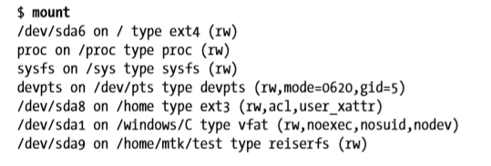
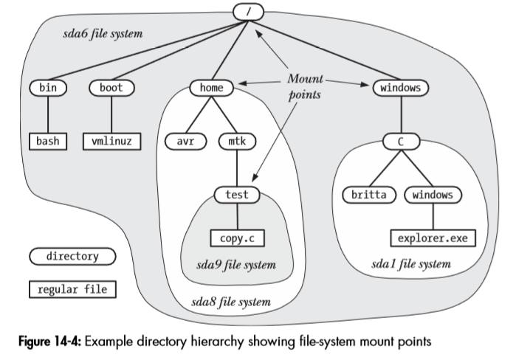

Slide 19
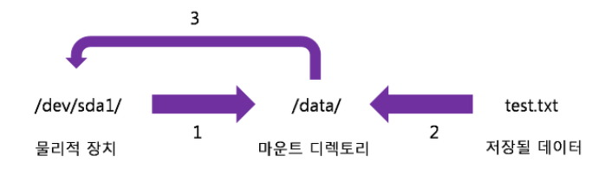
The linux programming interface
14.8 Mounting and Unmounting File Systems
The mount() and umount() system calls allow a privileged process to mount and unmount file system..
리눅스에서는 하드디스크의 파티션, CD/DVD, USB메모리 등을 사용하려면 특정한 위치에 연결을 해 줘야 한다. 이렇게 물리적인 장치를 특정한 위치(대개는 디렉토리)에 연결시켜 주는 과정을 마운트라고 한다.
리눅스의 /proc/mounts 가상 파일에서 현재 마운트된 파일 시스템의 목록을 확인 가능하다.

Slide 20
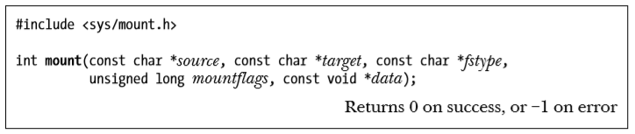
The linux programming interface
- Mounting a file System : Mount()
- The mount() system call mounts the files system contained on the specified by source under the directory (the mount point) specified by target.
source: 명시된 디바이스에 포함된 파일 시스템
target: 마운트 지점
fstype: 파일시스템 타입
mountflags: 플래그
Data: 해석이 파일 시스템에 따라서 다른 정보 버퍼의 포인터

Slide 21
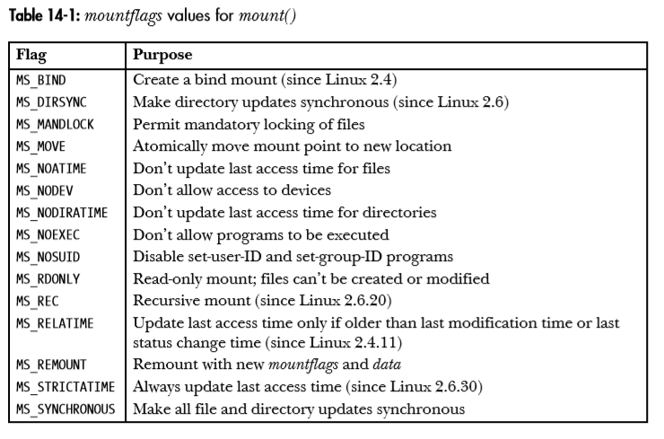

Slide 22
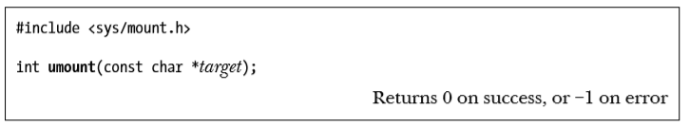
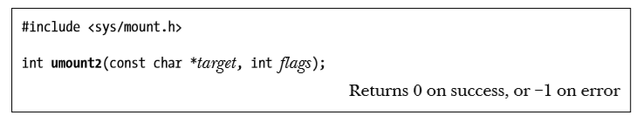
The linux programming interface
- Unmounting a file System : umount() and umount2()
- The umount() system call unmounts a mounted file system.

Slide 23
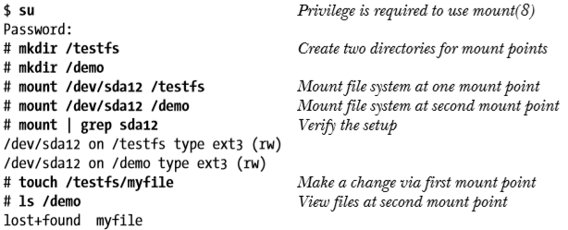
The linux programming interface
14.9 Advanced Mount Features
- We look at a number of more advanced features that can be employed when mounting file system..
- Mounting a file system at Multiple Mount Points
From kernel 2.4 onward, a file system can be mounted at mounted at multiple locations within the file system.
Because each on the mount points shows the same subtree, changes made via one mount point are visible through the other(s)

Slide 24
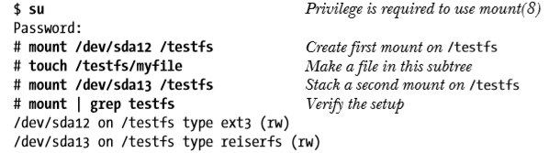
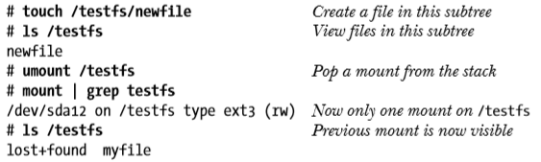
The linux programming interface
- Stacking Multiple Mounts on the Same Mount Point
Since kernel 2.4, Linux allows multiple mounts to be stacked on a single mount point.
Each new mount hides the directory subtree previously visible at that mount point.
When the mount at the top of the stack is unmounted, the previously hidden mount become visible once more.

Slide 25
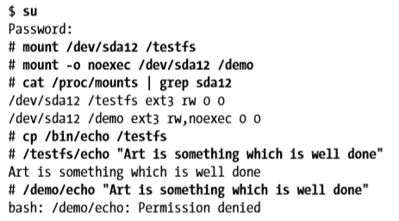
The linux programming interface
- Mount flags that are per-Mount Options
Because this no longer holds in linux 2.4 and later, some on the mountflags values can be set on a per-mount basis.
These flags are MS_NOATIME, MS_NODEV, MS_NODIRATIME, MS_NOEXEC, MS_NOSUID, MS_RDONLY and MS_RELATIME.

Slide 26
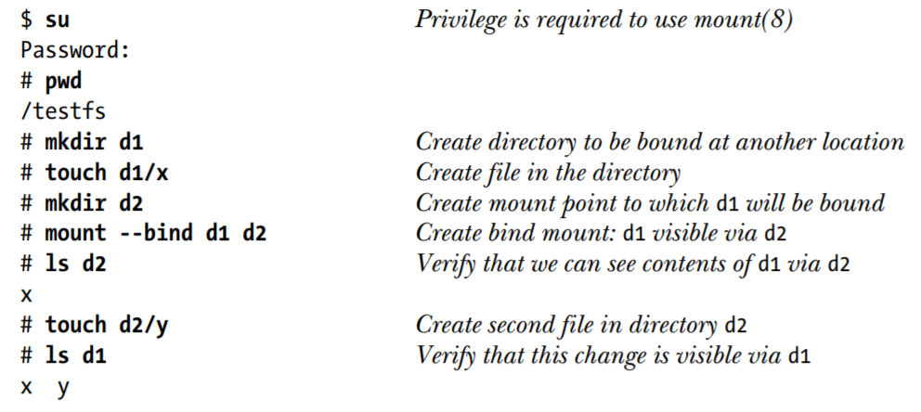
The linux programming interface
- Bind Mounts
Starting with kernel 2.4, Linux permits the creation of bind mounts.
A bind mount allows a directory or a file to be mounted at some other location in the file- system hierarchy.
This results in the directory or file being visible in both locations.

Slide 27
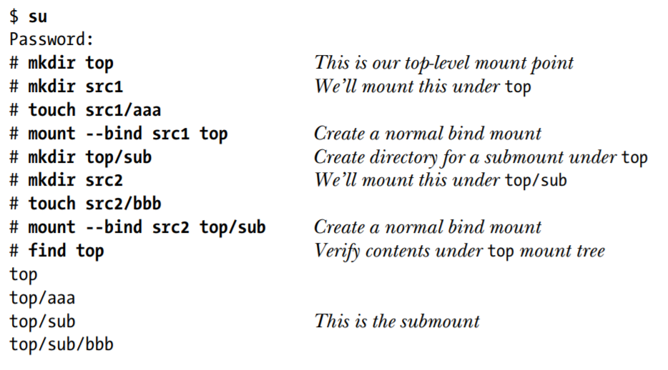
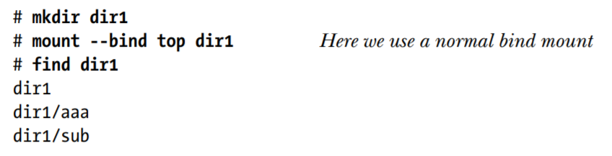
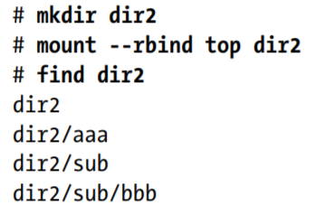
The linux programming interface
- Recursive Bind Mounts
Because this no longer holds in linux 2.4 and later, some on the mountflags values can be set on a per-mount basis.
These flags are MS_NOATIME, MS_NODEV, MS_NODIRATIME, MS_NOEXEC, MS_NOSUID, MS_RDONLY and MS_RELATIME.

Slide 28

The linux programming interface
14.10 A Virtual Memory File System : tmpfs
- tmpfs(Temp file Sorage)
Tmpfs는 유닉스 계열 운영체제의 임시 파일 스토리지 기능을 일컫는 이름이다. 마운트된 파일 시스템 처럼 보이지만 영구적인 기억장치가 아닌 휘발성 메모리에 저장된다 가성 드라이브처럼 보이면서도 디스크 파일 시스템을 호스팅하는 램 디스크와 구조가 비슷하다.
Tmpfs는 리눅스 커널 버전 2.4 이상부터 지원하고 시동 중 사용되는 ramfs 코드에 기반을 두며 페이지 캐시를 사용하지만, ramfs 와 는 달리 덜 사용되는 페이지들을 스왑 공간으로 스왑 아웃처리를 지원하며, 메모리 부족 상황을 피하기 위해 파일 시스템 크기와 inode 제한을 지원한다. 이러한 옵션은 마운트 시 설정되며 파일 시스템을 다시 마운트함으로써 수정할 수 있다.

Slide 29
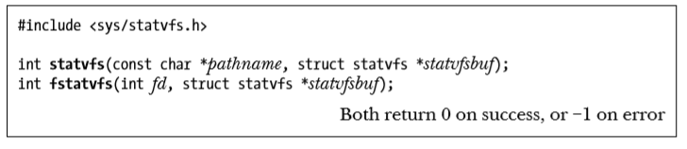
The linux programming interface
14.11 Obtaining information about a file system
: statvfs()
The statvfs() and fstatvfs() linbrary functions obtain information about a mounted file system.
The only difference between these two function is in how the file system is identified..
statvfs(), we use pathname to specify the name of any file in the file system.
fstatvfs(), we specify an open file descriptor, fd, referring to any file in the file system.

Slide 30
THANK
Y O U

